Slide 1
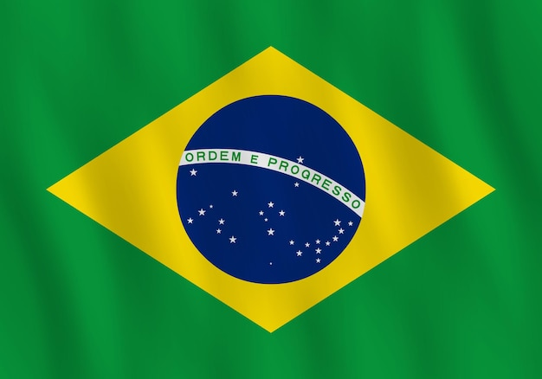
CHRISTMAS
IN BRAZIL

Slide 2
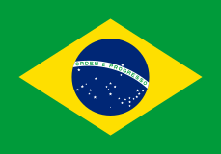
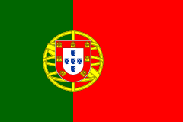
Brazil is a country wich is
a mix of different ethnic
societies.
The biggest influence on Brasilian
Christmas traditions have had
Portuguese, but there are African
and Indian elements of
Tradition.

Slide 3
In some weeks before Christmas in companies people play „Invisible friend”, that is a suprised present for one of colleagues.

Slide 4
Children write special cards to Santa Claus with a list of presents they would like to get.

Slide 5
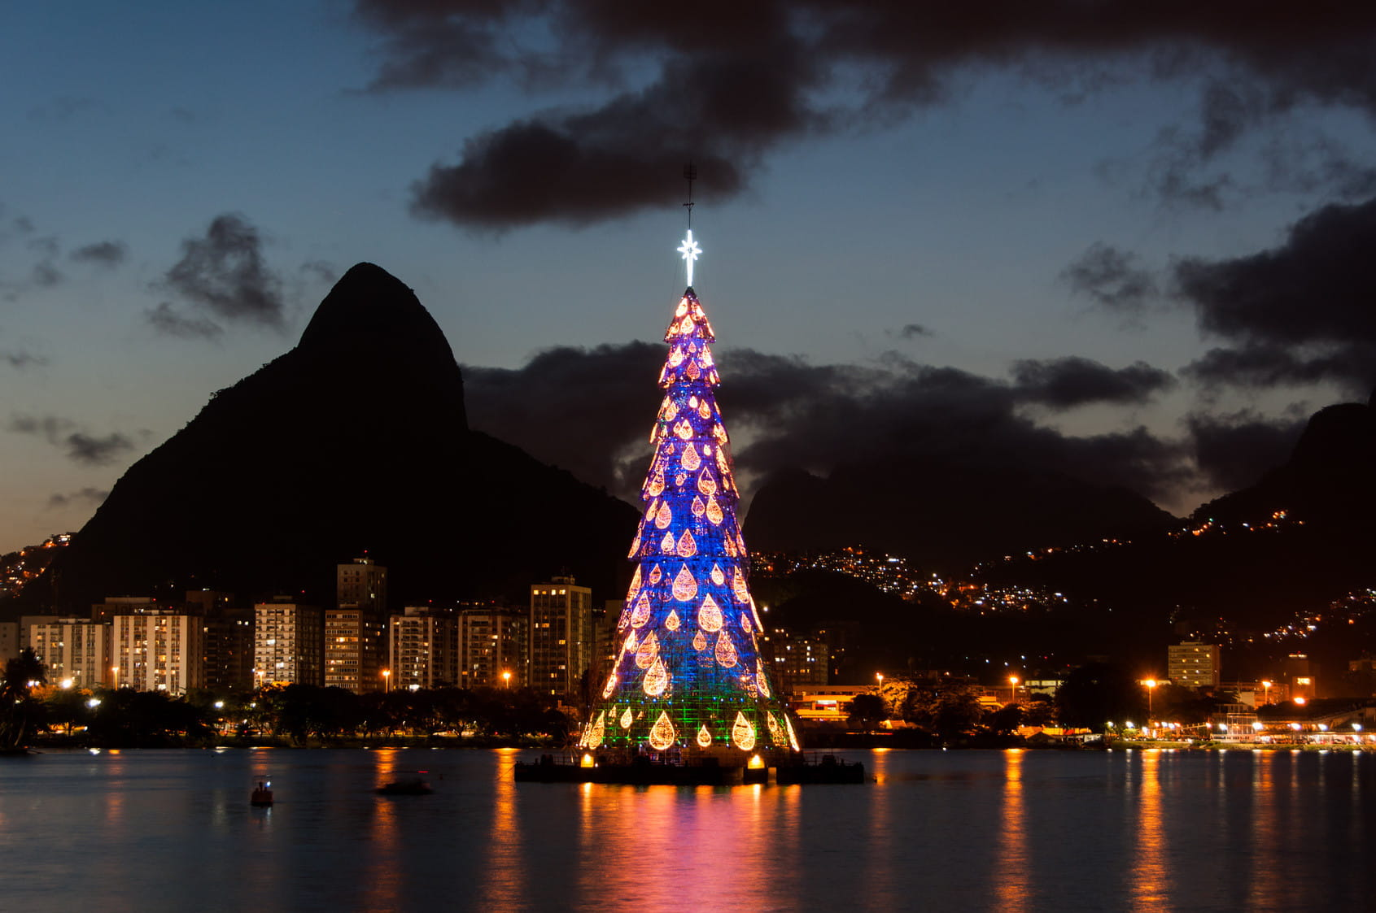
They put the biggest in the world swiming Christmas tree on Rodrigo de Freitas lake in Rio de Janeiro.

Slide 6
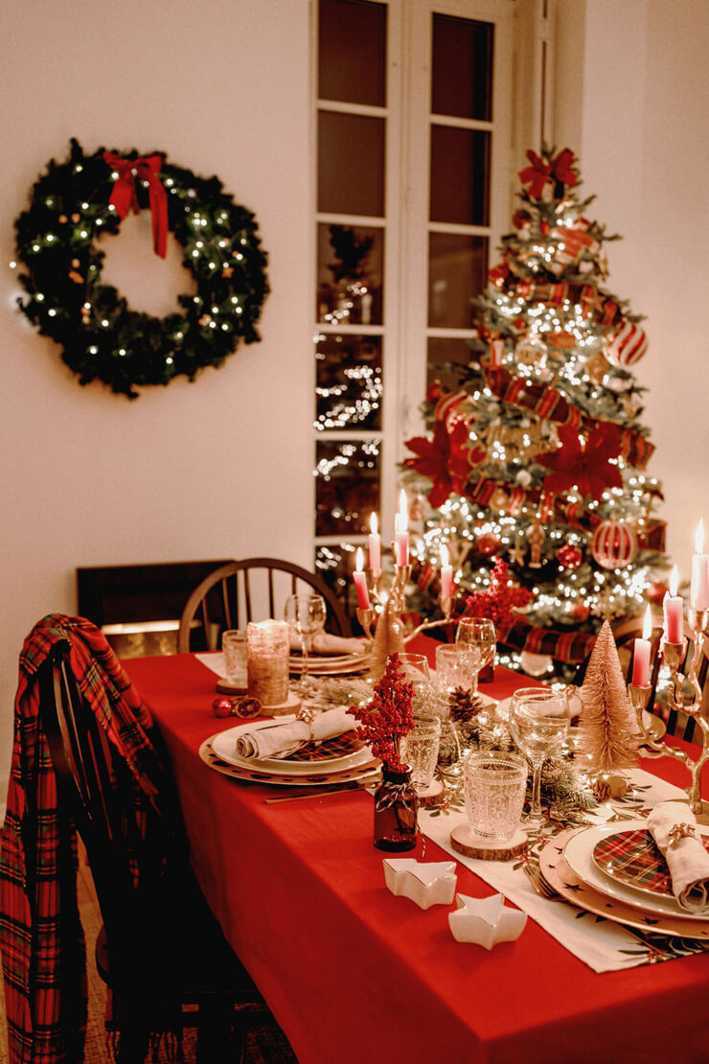
Later all members of family meet at home to celebrate this happy day at Christmas table.

Slide 7
At midnight, Santa Claus (Papa Noel) walks from house to house and give presents.

Slide 8
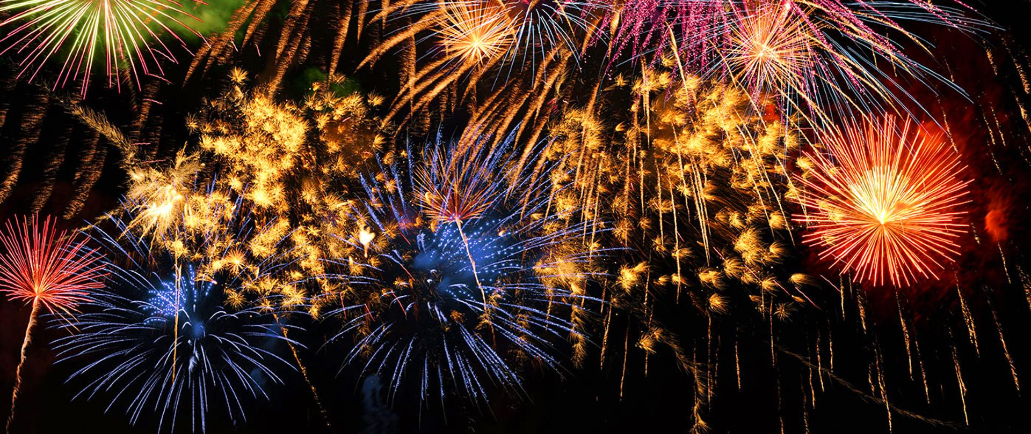
Later you can watch a firework show wich means cheerfulness and happienes because of Jezus inflant.

Slide 9
In Brasil Christmas time is in the summer and people spend a lot of time on the beach for example Copacabana in Rio de Janeiro.

Slide 10
Michał Nowak 6B

